Slide 1
Event Based Asset Management System
Christian Bissett

Slide 2
What is EBAMS
EVENT Based Asset Management
All Major events related to an asset can be tracked in a social media like timeline to tell a narrative and provide decision makers the information they need to make informed decisions.
Dispatches, Maintenance events, Part Arrivals and Installations are all tracked as a STORY of what an asset goes through.
Comments attachments and differentiation between human content and automated history to enhance story telling ability.

Slide 3
EBAMS as a General Management Software
Has Tools to serve as a foundation for a dispatch management tool
ready for YOU to extend to YOUR needs
Dispatching
User management
Asset management
Inventory Management

Slide 4
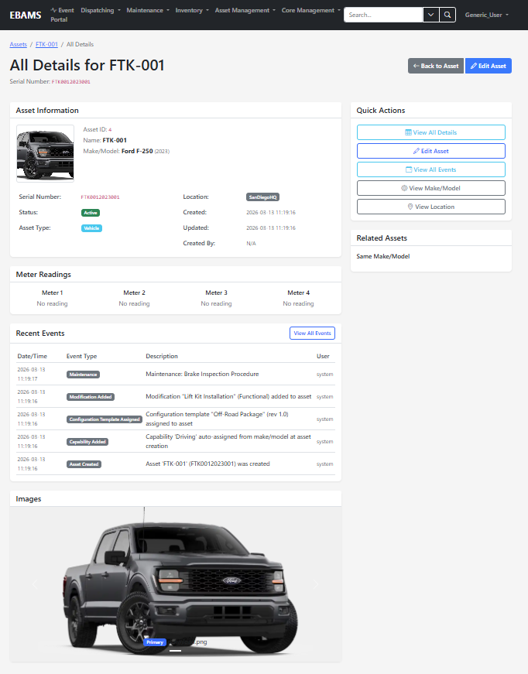
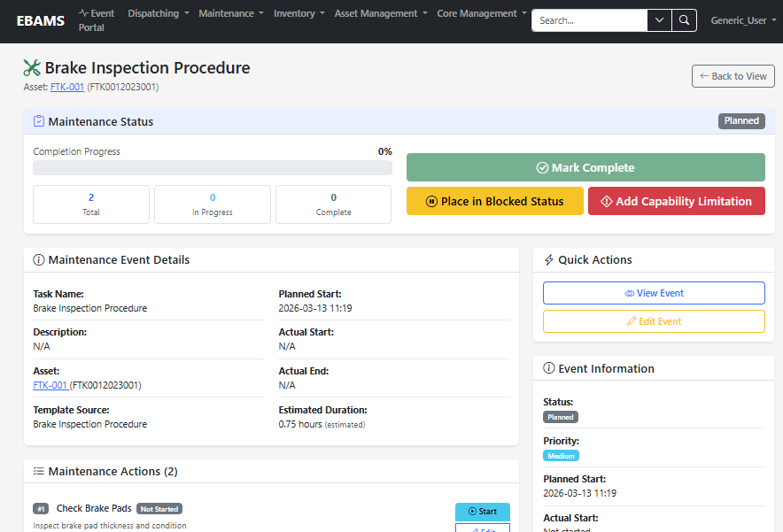
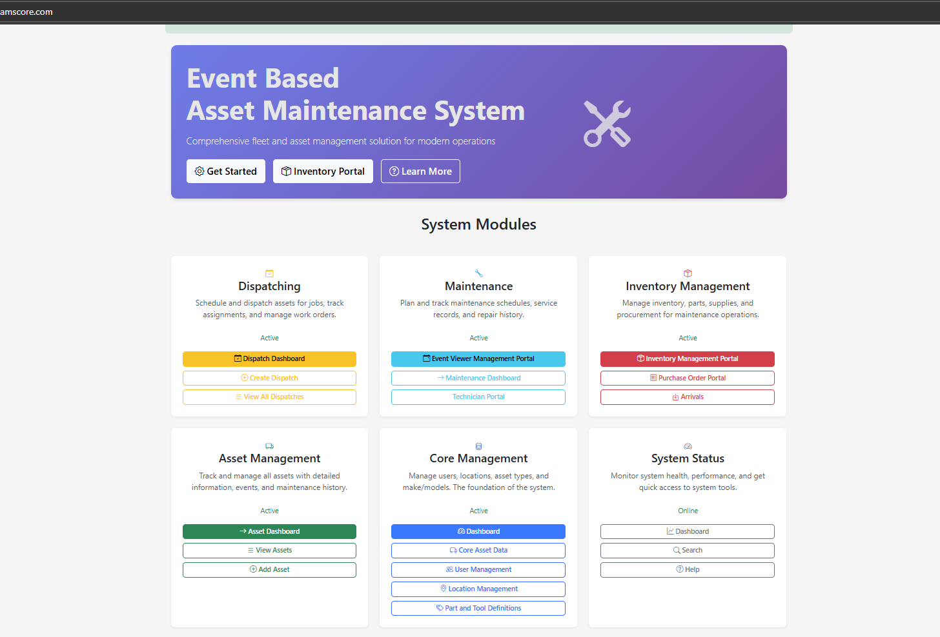
Portal Based System
BIG easy to use Buttons in a modern UI framework

Slide 5
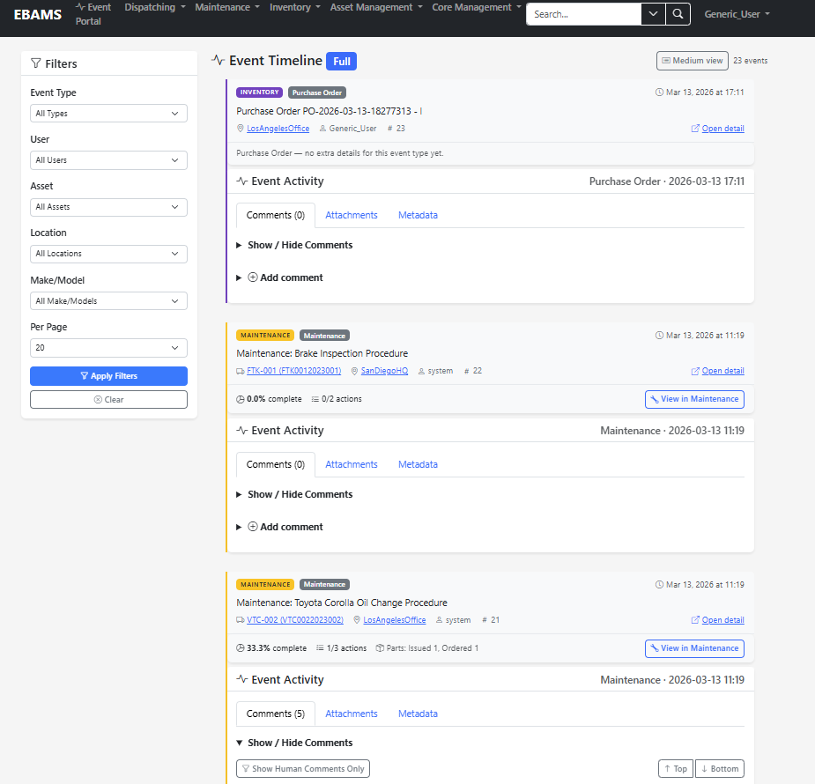
Timeline View

Slide 6
Improvements over Current Methods
Cost Efficiency
Application can Scale Without Additional cost.
No Complex Contracting process.
Ease of Use Saves Time.
Enhanced Downtime Tracking
Multiple Columns to track Capability Limitations, Limitation Types, Lost Time and Blockers.
Event Based Tracking
Every Maintenance Activity, Dispatch, and Configuration Change Tells a Story.
At a glance information to make decisions.
Better accountability tracking via comments.

Slide 7
Policy Drives Software
Current Software Providers Do Not respond or implement to mission critical features for NSWC.
EBAMS is Directly Accountable to YOU.
Onsite Ownership of code and AI enhanced coding allows decision makers to make a statement and then have immediate updates.

Slide 8
Cost
Locally hosted and infinitely scalable
You OWN the data
No Surprise Licensing Cost.
Unlimited users and Assets.
Policy Drives Software
AI ready
Built By AI for AI.
Features can be implemented by a small team Rapidly
Saved time from quick adjustments to meet the needs of users in the field.

Slide 9

AI enabled Architecture
Written using teams of agents and modern AI commands
Uses a Simple Modern tech stack
Python, Flask, Bootstrap, HTMX, SQL alchemy
Architecture is optimized for AI feature integration
AI prefers a simple folder structure with plain English names
Layered data business and presentation architecture directs AI Directly to problems
Layered independent and EXTENDABLE modules so that changes in one module don’t break other modules for fast prototyping.

Slide 10
Enhanced Maintenance Model
Visually Intuitive work platform makes it easier for technicians to record work properly
Features Designed to directly track temporary modifications and capability limitations
Automatic Maintenance Planning with Conditional Logic based on Time, Usage, or Both

Slide 11
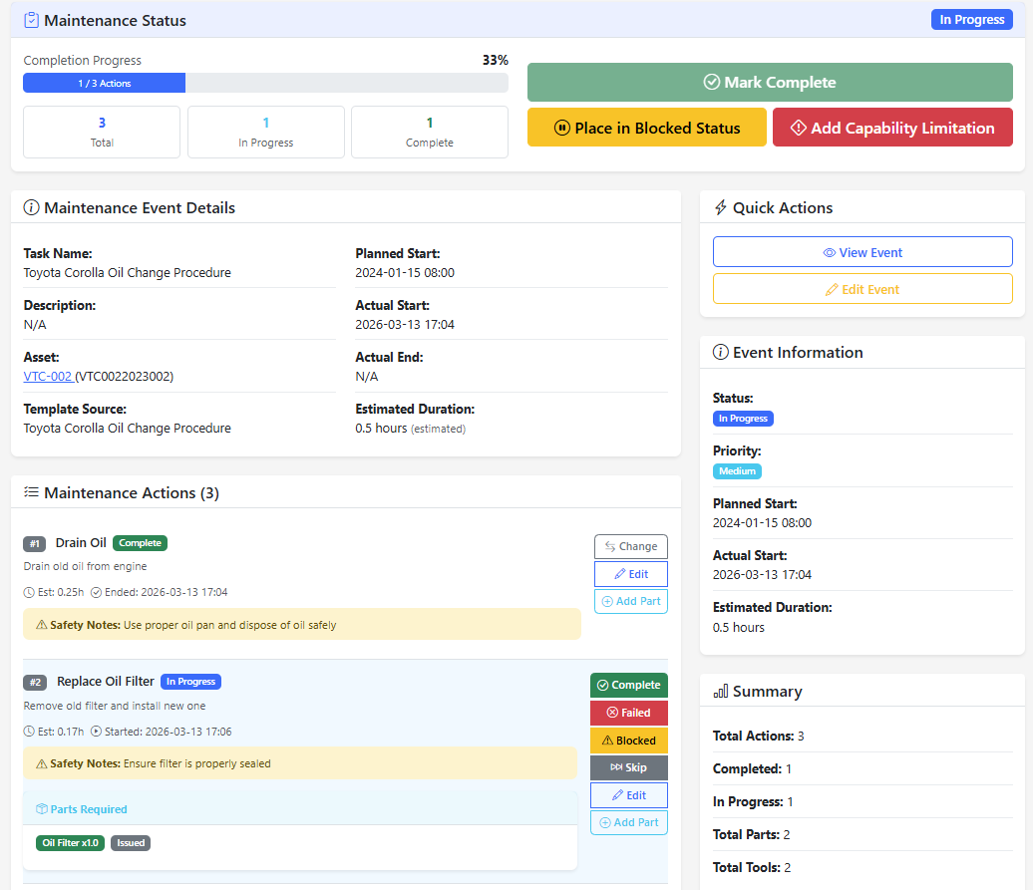
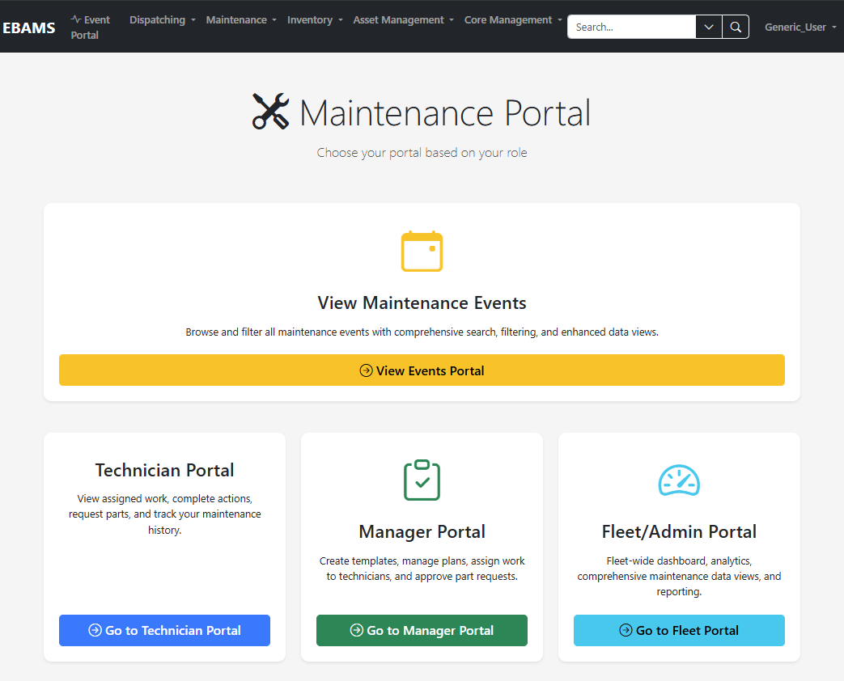
Maintenance Modules
Work Portal
Template Design
Daily Scan and Auto generation of overdue maintenance
Integration with Technical Library

Slide 12
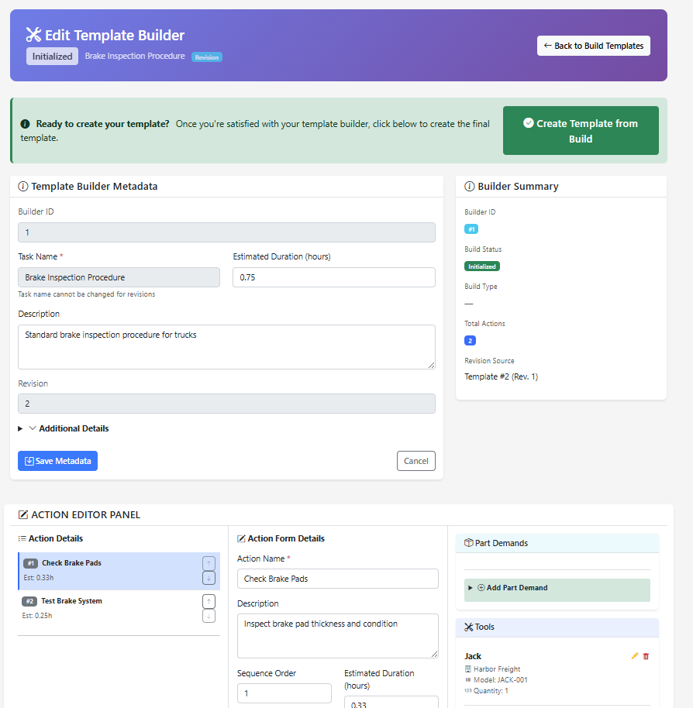
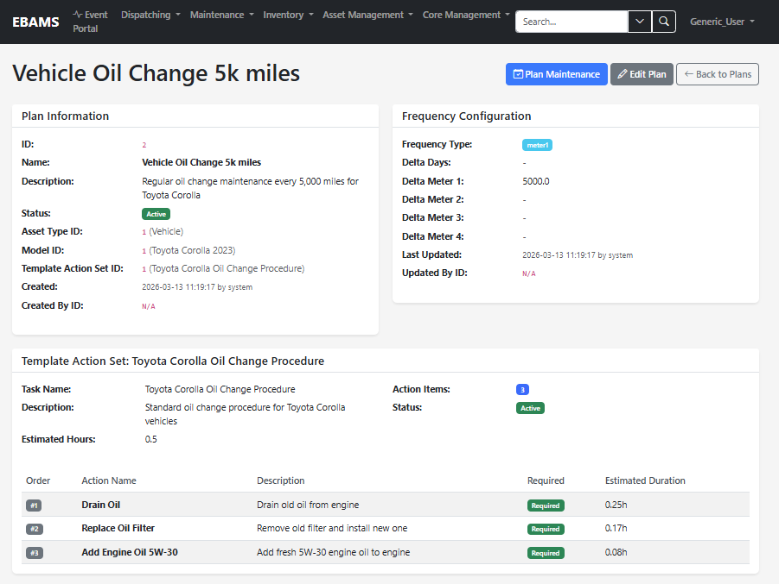
Templates and Plans

Slide 13
Enhanced Dispatching Process
Create
Create Requirements
Find
Find Required Personnel And Equipment for Mission Requirements
Match User and Equipment Availability to Capability Requirements
Build a Capabilities Profile For Users and Equipment
Store Common Requirements Templates
Dispatch
Reserve Assets, Personnel, and Issue Equipment

Slide 14
Current Capabilities
Request Template Header
Alternative Outcome
Rejection
Dispatch Assets
Reservation
Dispatch Manifest Header
Requested Capabilities
Capabilities
Asset Capabilities
Assets
Requested skills
Skills
User Skills
Users
Dispatch Users
Requested Parts
Parts
Dispatch Parts

Slide 15
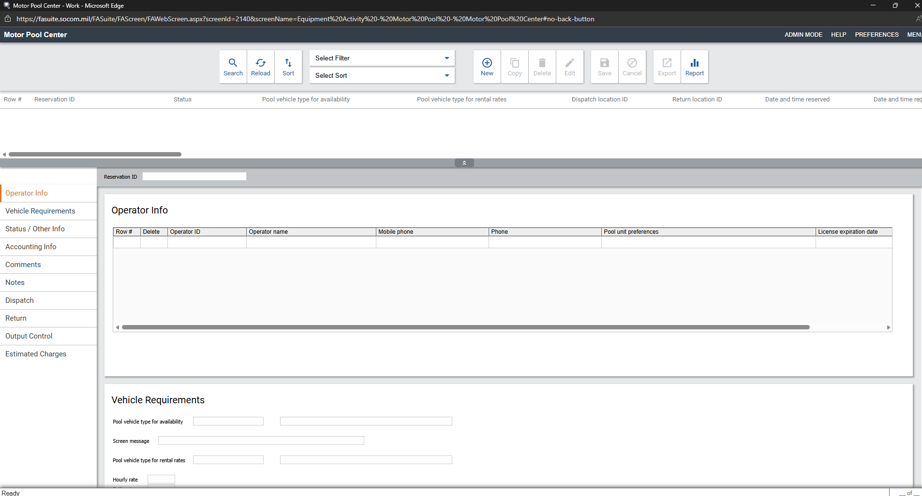
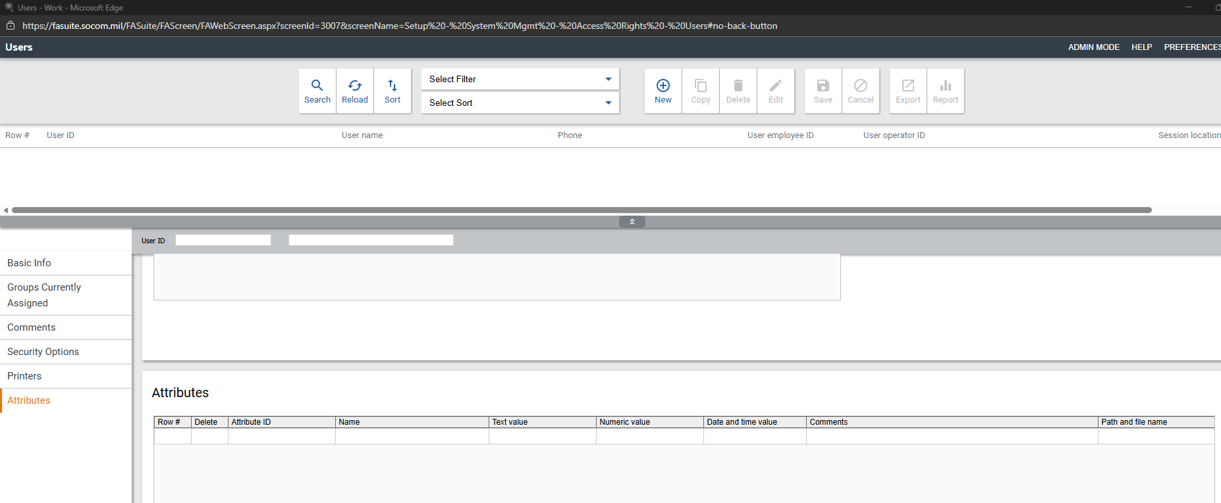
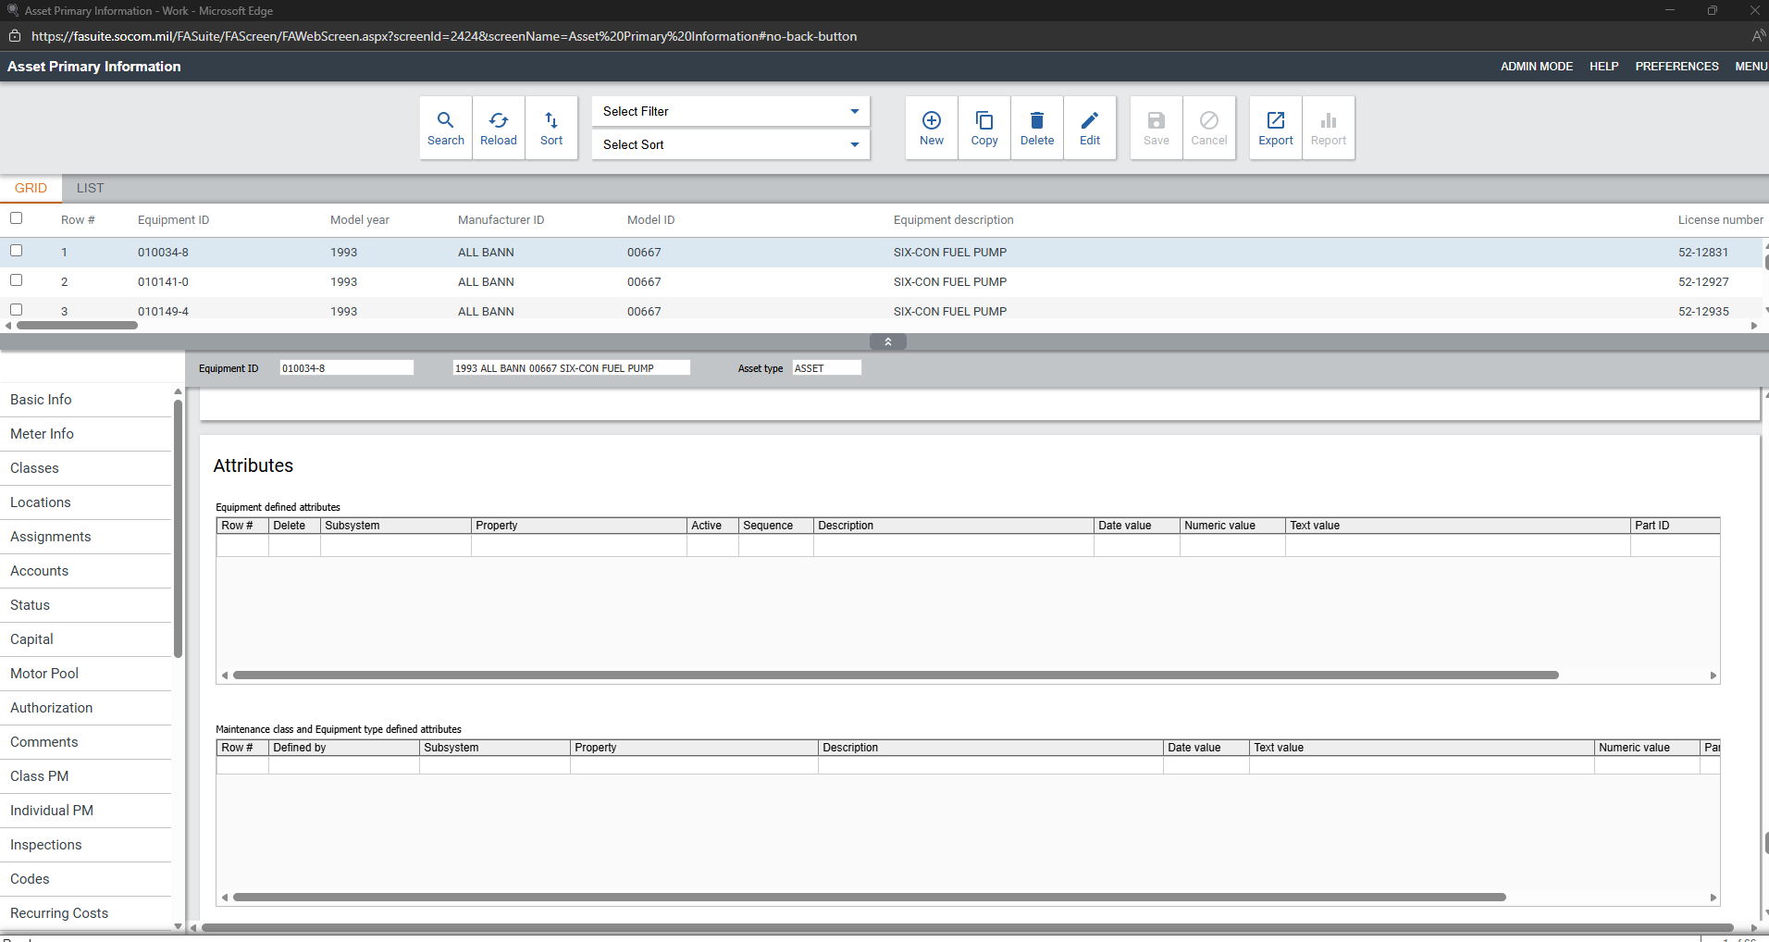
Current
Dispatching is primarily handled through one Screen

Slide 16
Simple Inventory Process
A Maintenance Activity or Dispatch Creates Part Demand
Part Demands can be linked to Purchase orders
Parts Arrive
Arrivals get stocked
Stocked items are issued to Part Demands

Slide 17
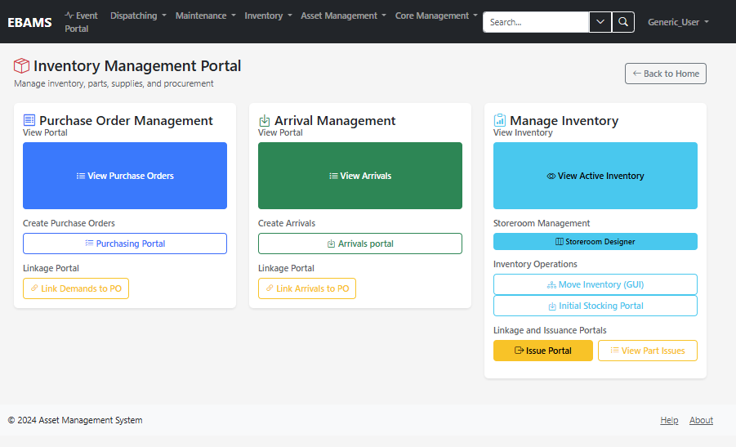
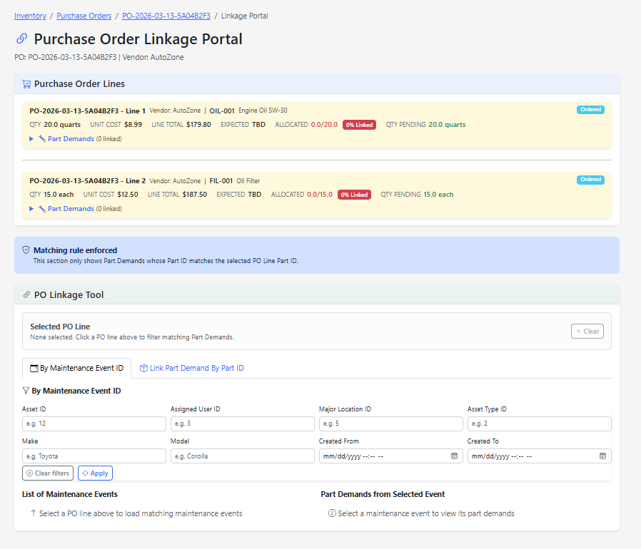
Portals and Linkage
Visual tools to make it clear that items are linked to each other
Purchase orders can be created for stock in advance and linked to maintenance events as they arise

Slide 18
Inventory
Multi Dimensional Status
Approval, Purchasing State, and Physical Issue state of parts
Users often grab parts and self issue without telling supply
Gives users the ability to track the TRUTH and provides tools to make corrections
Visual Stocking and Part finding
Allows inventory managers to select locations within the warehouse and place parts

Slide 19
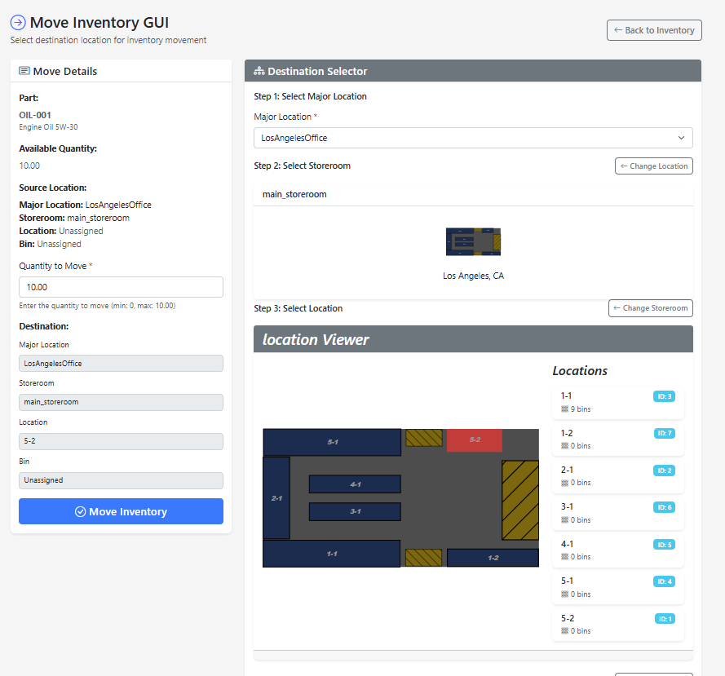
Inventory GUI
Users Create an image using open source tools
Image is automatically parsed to create locations and bins
Users can accept parts to the warehouse then assign to a location

Slide 20
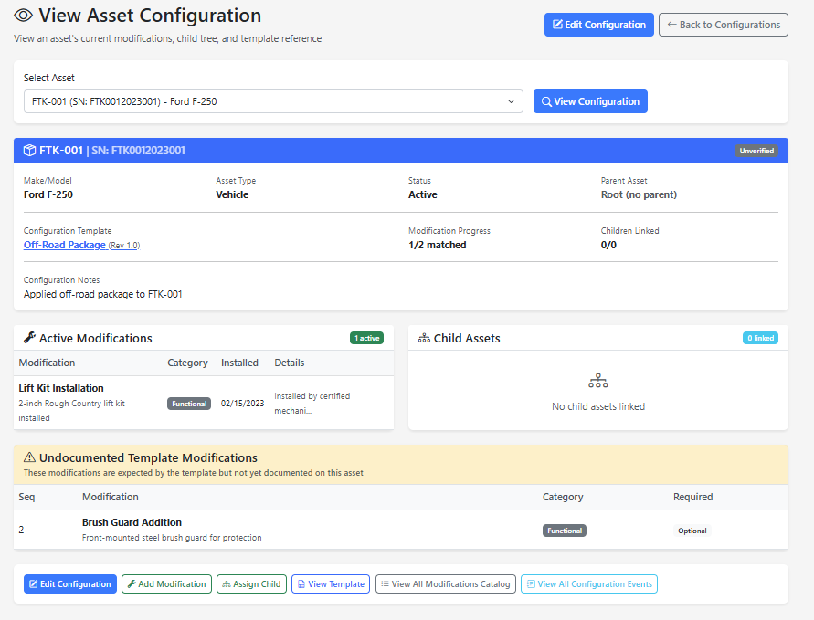
Configuration Management
Configuration templates outline what items are expected and the structure of the configuration
Assets can be assigned templates children and modifications.
Templates can have Recursive Configuration Expectations for Children

Slide 21
Capabilities
Capabilities can be automatically inherited by their asset class or make model
Capabilities help dispatchers make decisions about what to issue out
(Not a tool for blindly detailing everything an asset can do)

Slide 22
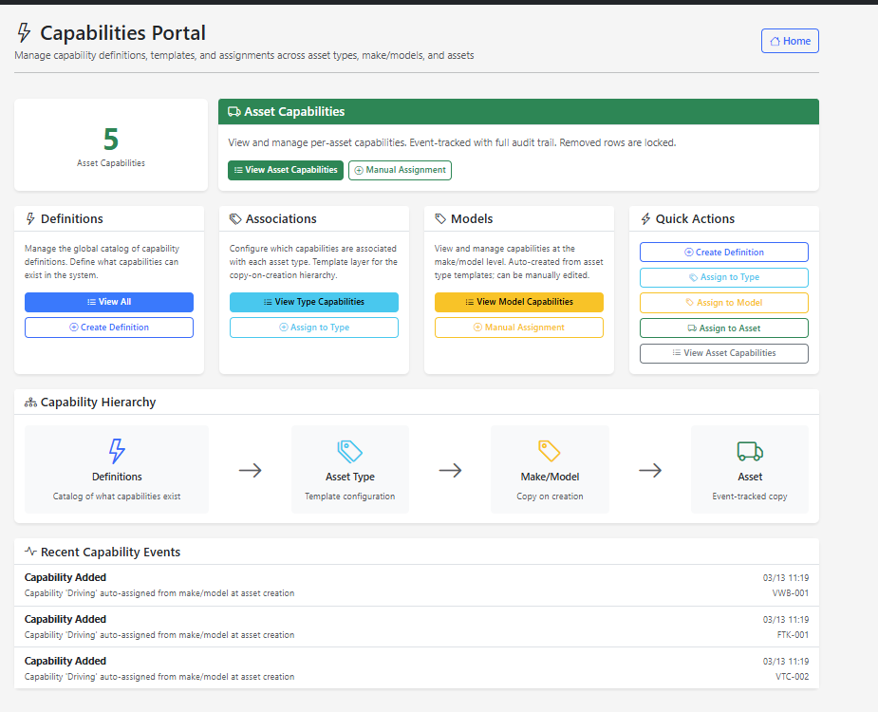
Capabilities portal

Slide 23
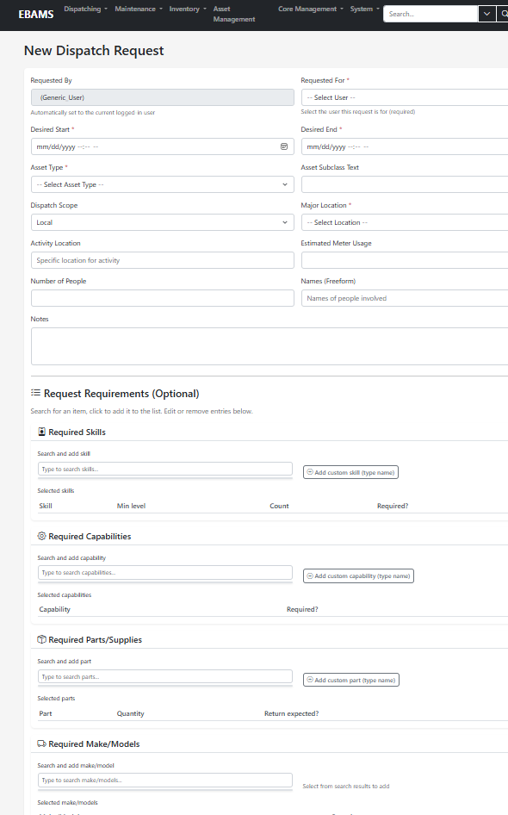
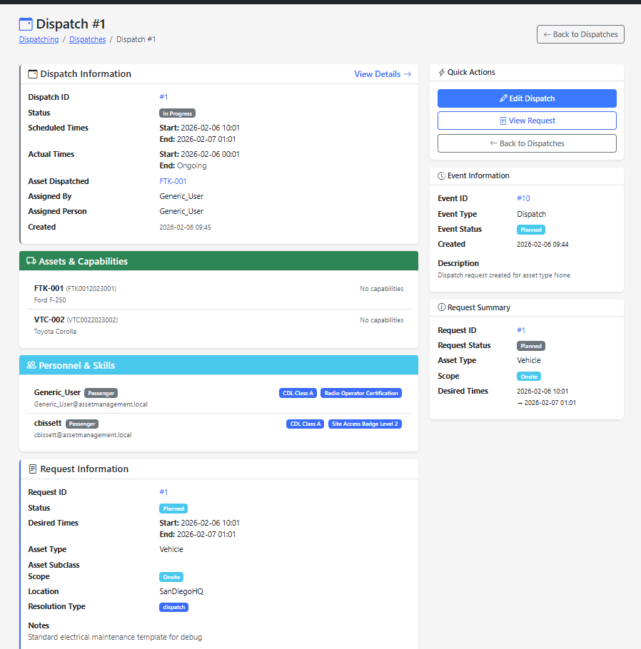
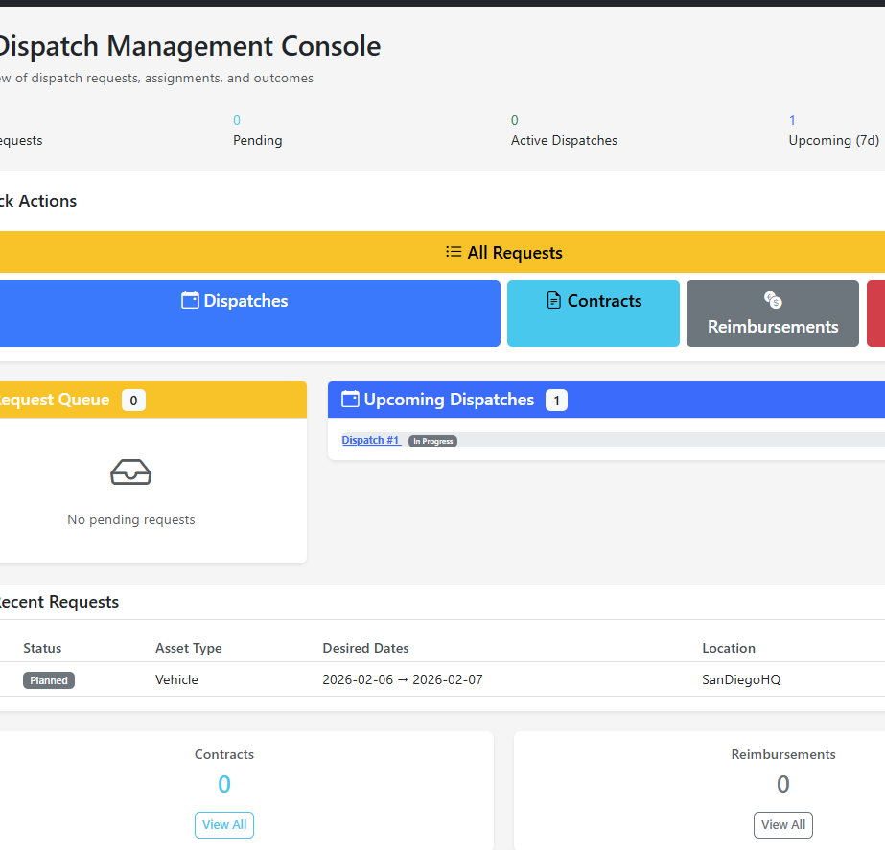
Architecture and Demo
Ebamscore.com
Repo

